Slide 1
Using Lotteries to Enhance Fairness: Insights from the TMI Program
Chris Anderson, Director Policy & International

Slide 2

Theo Murphy Initiative
Established to further scientific discovery and support activities that benefir EMCRs
Funding streams:
Flagship – usually an event up to $50k
Amplify – add on an event or symposium
Participation support grant
Notes:
The Australian Academy of Science’s Theo Murphy Initiative (TMI) Participation Support Grants (PSG) are dedicated to helping early- and mid-career researchers (EMCRs) overcome significant financial and accessibility barriers. These grants, valued up to $5,000 per individual, enable participation in vital career-development activities like conferences and workshops. Our goals with the PSG are clear: enhance fairness, ensure transparency, reduce administrative burden, and importantly, provide unbiased data for policy evaluations.

Slide 3
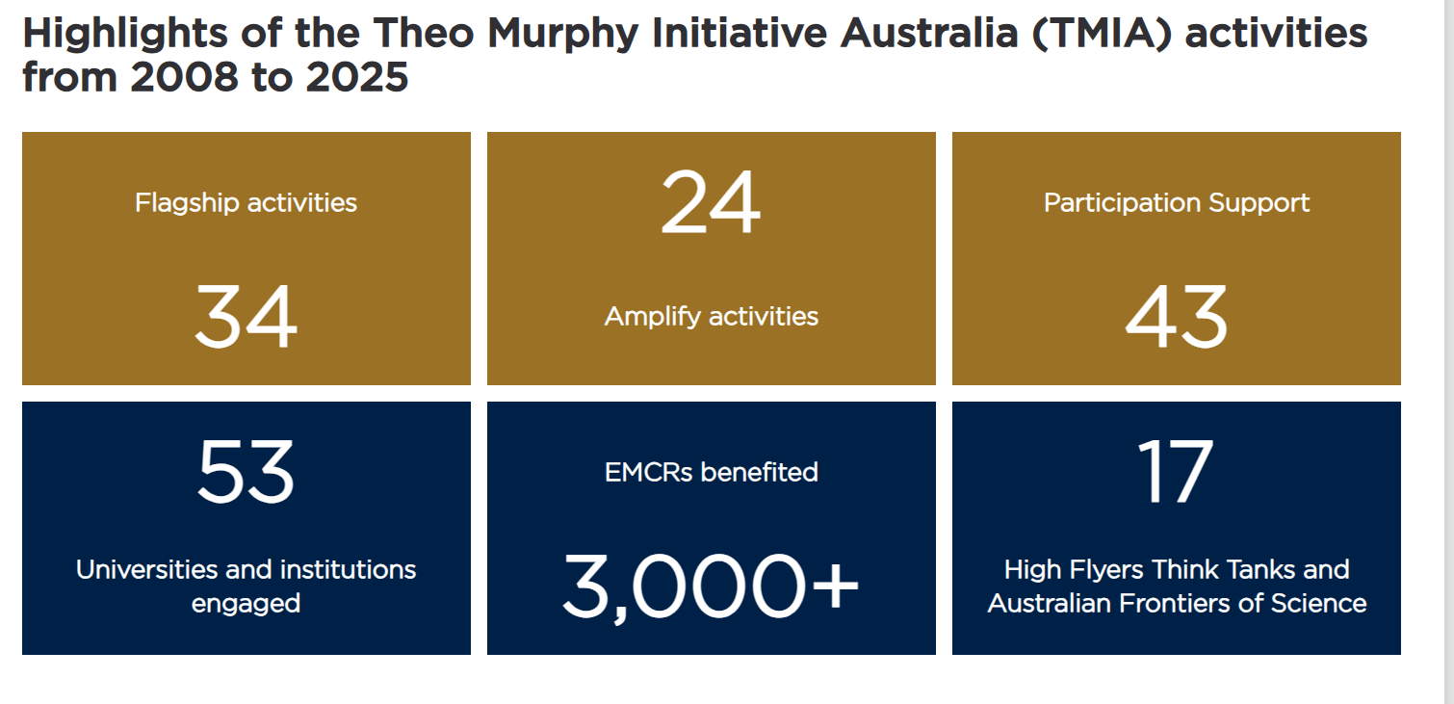

Slide 4
Participation Support Grants
Allocation of limited funds to early- and mid-career researchers (EMCRs)
Objectives:
Address financial and logistical barriers for EMCRs
Ensure fair and equitable distribution of resources
Minimise bias and administrative overhead
Notes:
The Australian Academy of Science’s Theo Murphy Initiative (TMI) Participation Support Grants (PSG) are dedicated to helping early- and mid-career researchers (EMCRs) overcome significant financial and accessibility barriers. These grants, valued up to $5,000 per individual, enable participation in vital career-development activities like conferences and workshops. Our goals with the PSG are clear: enhance fairness, ensure transparency, reduce administrative burden, and importantly, provide unbiased data for policy evaluations.

Slide 5
Why a Lottery?
First-come, first-served vs peer review vs conditional lottery
Objective: more equally distribute funding to achieve regional and institutional diversity
Rigorous eligibility screening:
Verification of EMCR status
Budget scrutiny and feasibility
Comprehensive documentation review
Notes:
Initially, PSG awards were allocated using a first-come, first-served basis, which unintentionally favoured certain groups or institutions. In 2023, the Academy introduced a conditional lottery system, significantly improving fairness by selecting randomly from a pool of thoroughly vetted applicants.
A random draw generator was introduced to maintain fairness and transparency, modelled on practices adopted by other research funding bodies such as the Health Research Council of New Zealand for Explorer Grants, the British Academy/Leverhulme Small Research Grants, the Swiss National Science Foundation for Postdoc mobility grants, the Austrian Science Fund for 1000 Ideas Programme, and the Volkswagen Foundation for creative research ideas.
Eligibility criteria are strict, including validation of EMCR status, practical budget proposals, and required documentation, thereby maintaining high-quality standards.
This approach was informed by similar successful implementations globally, such as the Health Research Council of New Zealand’s Explorer Grants and the British Academy’s Small Research Grants.

Slide 6
Practical Implementation and Refinements
Geographical equity was introduced in 2024
Selection aligned with state and territory size, research activity
Standby applicants system to maximise the utilisation of funds
Benefits overall = reduction of implicit biases, equal opportunity
Notes:
The random draw method ensures all eligible applicants have an equal opportunity, mitigating biases and administrative burden. Each applicant undergoes a thorough eligibility assessment before entering the draw, ensuring quality control.
To further refine this approach and ensure equitable distribution, the Academy introduced geographical considerations in 2024. Applicants were grouped by state and territory, and allocations were proportionate to regional research activity and institutional presence. This structural adjustment enhanced geographic diversity and equitable resource distribution. Additionally, we introduced standby applicants, significantly improving the overall efficiency and utilisation of funds.
Using a conditional lottery significantly reduces both explicit and implicit biases inherent in subjective assessment methods, such as merit-based reviews. This provides an equal chance to all eligible applicants, regardless of institution or background.
Questions have been raised as to alternatives, such as a more detailed assessment to verify the applicants scientific excellence or the like.

Slide 7
Insights, Recommendations, and Future Considerations
Maintain and regularly review the lottery method
Addressing potential criticisms and misconceptions
Invitation for broader policy adoption and collaboration
Notes:
Our experiences suggest strongly that the conditional lottery model is highly effective, fair, and administratively efficient. We recommend maintaining this approach, with annual reviews to continually improve the system. It's crucial to communicate clearly to mitigate any misconceptions—such as lotteries avoiding meritocracy—to foster wider acceptance. To conclude, the conditional lottery used in the Academy's TMI program stands as a powerful tool for equitable resource distribution and unbiased policy evaluation. It ensures fairness, reduces bias, and provides valuable insights into policy impacts. I welcome your thoughts, questions, and ideas on how we might further leverage this approach across other policy areas and look forward to our continued collaboration.
Using a conditional lottery significantly reduces both explicit and implicit biases inherent in subjective assessment methods, such as merit-based reviews. This provides an equal chance to all eligible applicants, regardless of institution or background. Importantly, the randomness inherent in lotteries creates natural randomised controlled trials (RCTs), enabling robust evaluations of grant effectiveness and providing policymakers with invaluable evidence. Similar to findings from Sweden’s medical degree lottery, this approach allows us to assess real-world impacts clearly and objectively.

Slide 8
Discussion and Q&A

